Slide 1

Machine Learning Hackathon CG 2022
Team Name - Tensor HOD
Team Leader Name - Soumen Sardar
Team Leader Email Address - soumensardarintmain@gmail.com

Slide 2
Brief description of the problem at hand:
Attacker use various fraudulent techniques to perform phishing attract while user is visiting certain websites.
Here we have a dataset containing 30 features indicating 3 flags:
-1 : Phishing
0 : Suspicious
1 : Legitimate
We have a Result column in the dataset which indicates:
-1 : Phishing
1 : Legitimate
Good balance between classes
Our task is to identify whether a certain website is Legitimate(1) or Phishing(-1) based on given 30 features.

Slide 3
Solution proposed and description:
The given dataset does not contain any null value which is good for us.
After dropping duplicate records, we have 5000 records
Our target variable is - Result.
All features are categorical in nature. We dropped `key` variable
On performing Exploratory Data Analysis(EDA), we found few features are highly correlated with the target variable.
We wish to build machine learning classification model to perform our classification task

Slide 4
Technology/Tool Stack Used:
Language: Python
Data Processing Libraries: Pandas, Numpy
Data Visualization Libraries: Matplotlib, Seaborn, Sweetviz
Machine Learning Library: scikit-learn, StatsModel, XGBoost
Platform: Google Collab
Model Serializer: Joblib 1.1.0
Algorithms: Logistic Regression, Decision Tree, Random Forest, XGBoostClassifier

Slide 5
Finding Dominant Features:
SSLfinal_State
URL_of_Anchor

Slide 6
Performance Metrics:
Performance Metric:
Our idea is to keep the False Negative Rate(FNR) as low as possible.
We also have taken a look on F1-score for various
Our key performance indicator is ROC-AUC

Slide 7
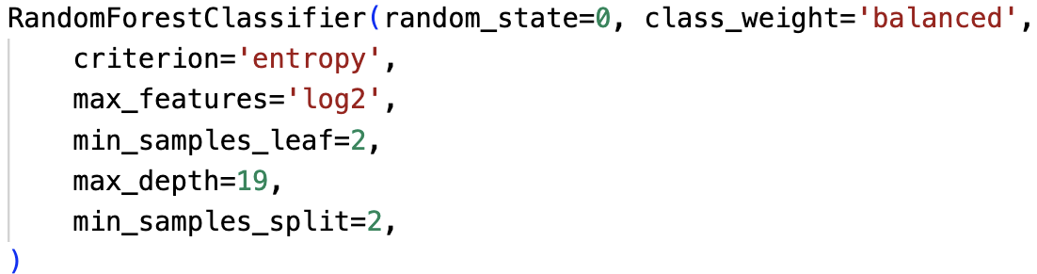
Approach:
Model:
In final round we took advantage of our past experience and started the model building with Decision Tree.
We fine tuned, both, Random Forest Classifier and XGBoost Classifier .
We have chosen our final model as `Random Forest`

Slide 8
XGBoost Classifier:
AUC: 0.9095396535168883
Best probability cutoff= 0.496552

Slide 9
Random Forest:
AUC: 0.908887597170155
Best probability cutoff= 0.486207

Slide 10
Model Comparison:
Factors | Random Forest | XGBoost
AUC | 0.9088 | 0.9095
Accuracy | ~81% | ~80%
Cutoff | 0.4862 | 0.4966
Base Line Match | 84.190% | 84.190%

Slide 11
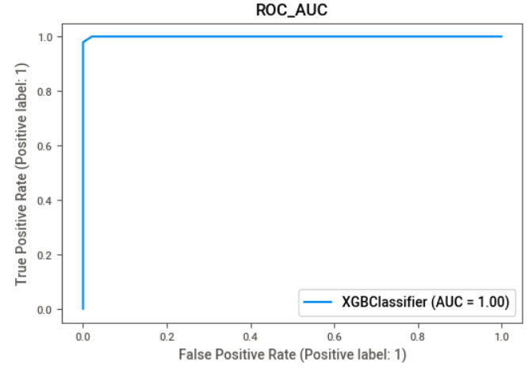
Impact Analysis:
Factors | ALL Features | Impact | Dropping 2-Dominant Feature
Model | XGBoost Classifier Heave Model |  | Random Forest Lite Model
AUC | 0.9998 |  | 0.9089
Accuracy | ~98% |  | ~80%

Slide 12
Source code as ZIP or Github URL:
GitHub URL:
https://github.com/Redcof/HPE_Machine_Learning_Hackathon_CG_2022

Slide 13
THANK YOU

